Slide 1


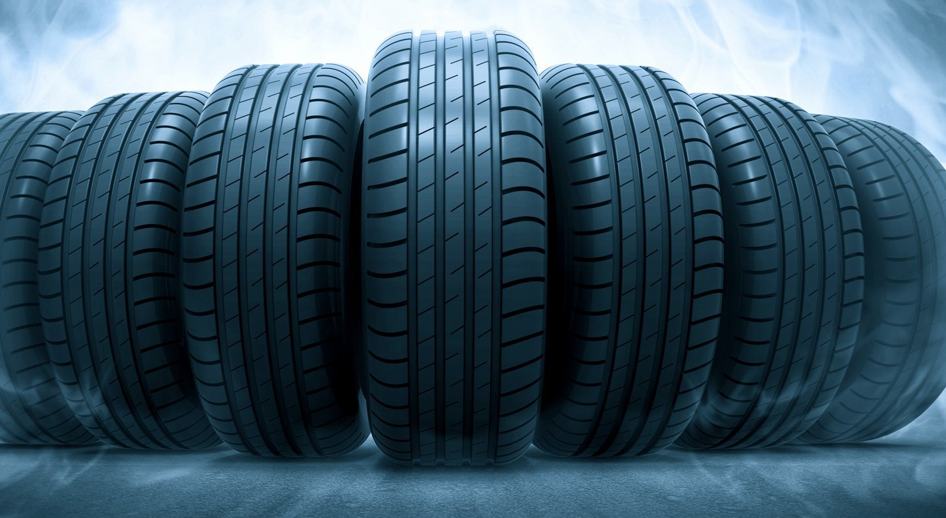
CODE_IN_INDIA
Problem Statement
Find Optimized Pattern for arranging tires in a truck
Team Members:
Deepam Gupta
Pratik Mehta
Jatin Gupta
Deep Kothari
Bhoomika Pandey
Rajat Karahe
Problem Code : SV2

Slide 2

Our Solution

Slide 3
Pattern Advisor
Web-App
New Technology
Pictorial Output
Database

Slide 4
INPUT
Truck Type : CTL, FTL, MXL, etc.
Loading Plan :
Product Id
Quantity

Slide 5
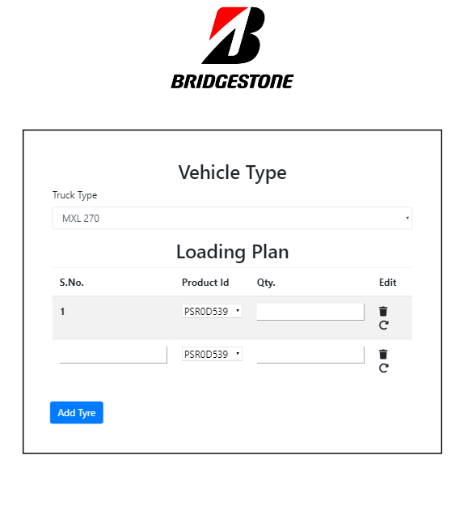

Slide 6
Process
1. Data stored in database.
2. Product Id is Unique :-
Weight
Loading
Volume
Tire code
3. Layer wise optimization of the truck.
4. Grid-wise output for easy understanding.

Slide 7
Technology Stack
Frontend : HTML5, CSS3, Bootstrap4, Javascript
Backend : Python-> Django
Database: MySQL
Output: Python->Matplotlib
Calculation: Python->NumPy

Slide 8
Futuristic Expansion…
Highly increase cost effectiveness
Fast and Accurate
Can be used in any logistic where
packing efficiency is involved
Can be converted into simulation
Can be used for training purpose

Slide 9
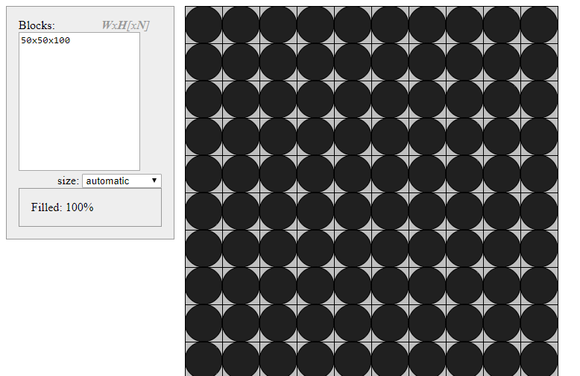
Sample Output

Slide 10
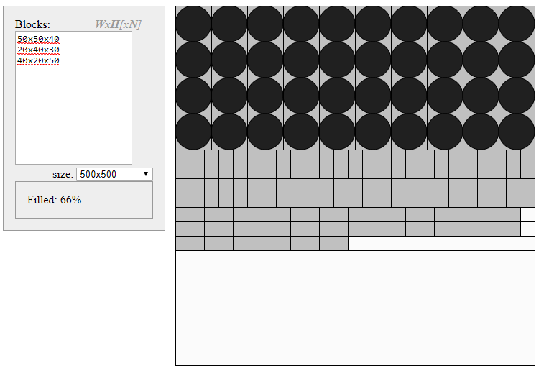
Sample Output

Slide 11
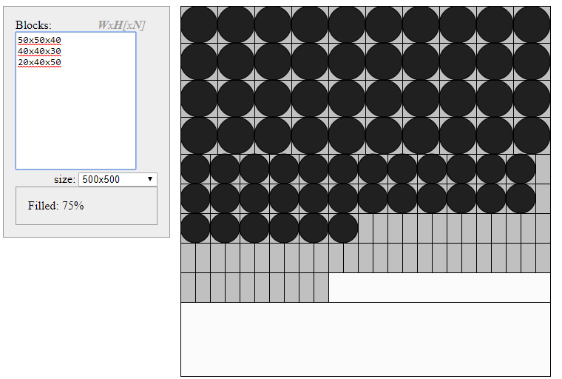
Sample Output

